Slide 1


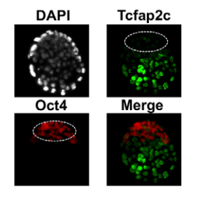
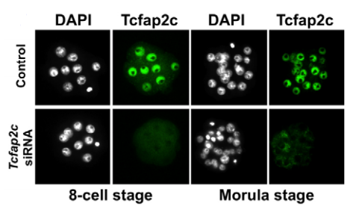
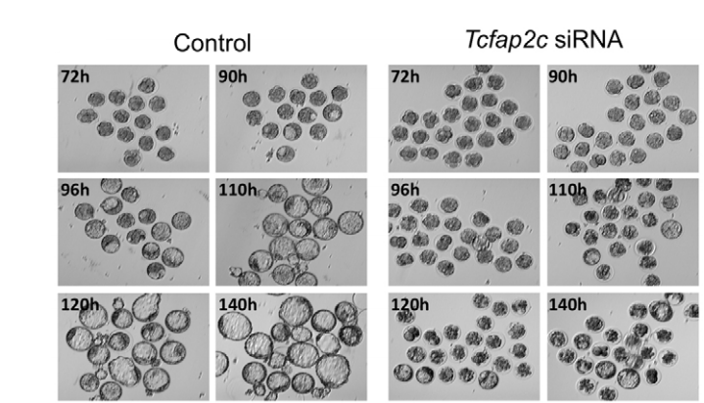
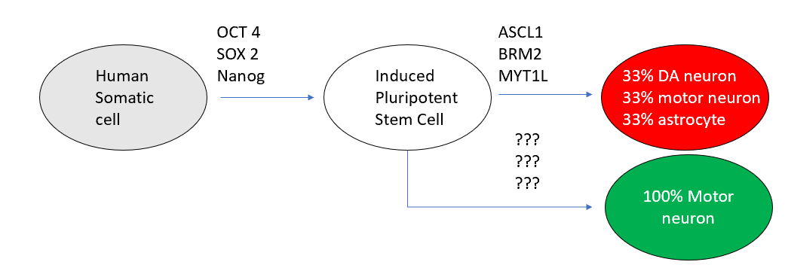
Stem-Cell Applications in Neuro-regenerative Therapies
Jason Knott Ph.D, Devin Carree, B.S.
Department of Animal Science, : Embryonic & Reproductive Biology
ABSTRACT
RESULTS
CONCLUSION
Many people today suffer from a wide array of diseases that affect the nervous system by degenerating nervous tissue, neurons and glia. Cells of the central and peripheral nervous system, unlike skin cell and bone cells, are not readily available to divide. When nervous tissues are destroyed, due to injury or disease, they are never able to recover which causes a significant loss of function in the life of a human being.
For diseases such as Parkinson’s disease, where only the dopaminergic neurons of substaintia nigra pars compacta of the midbrain are affected, stem cells have been proven to have the ability to alleviate the symptoms of Parkinson’s disease allowing people to live a life similar to having no disease at all .
In the Knott lab it was determined that tfap2-c is a core regulator of tight junction biogenesis and cavity formation during mouse early embryogenesis and thus differentiation. Depletion of tfap2-c blocks blastocyst formation. However, over expression of tfap2-c in mouse embryonic stem cells induces development of the trophectoderm endothelium.
This information has been used to create IPSCs. Adult human somatic cells terminally differentiated can be reprogramed into an embryonic-like state by restoration of endogenous pluripotency factors such as OCT4, SOX2, and Nanog .
Stem cells have been proven to have the ability to alleviate the symptoms of some neurological diseases allowing people to live a life close to having no disease at all. Although we don’t know the exact mechanism of how stem cells alleviate such ailments future research could shed some light on how exactly that happens as well as other important application.
A.
B.
INTRODUCTION
Stem cells are cells that can replicate themselves indefinitely as well as differentiate into many different types of cells. They are categorized, based on their ability to differentiate to other cells, as unipotent, multipotent, pluripotent or totipotent. The most useful type of stem cells, regarding generating new functional neurons, would be pluripotent or totipotent stem cells.
In the laboratory, with Dr. Knott, using a mouse model, fertilized embryos (totipotent) were obtained to determine the effects of Transcription Factor AP2-GAMMA (tfap2-c). It was determined tfap2-c is a key regulator of zygotic cell differentiation.
This type of information has been used to create induced pluripotent stem cells (iPSC) and can be used to create neural stem cells.
C.
FURTURE APPLICATIONS
Future application involving the use of neural stem cells include:
Cellular therapy / Disease Treatment
The gap in knowledge lies in finding the correct assortment of transcription factors and related proteins to achieve fully committed cells, bypassing immunorejection and blocking tumor formation.
Disease Modeling
To study the progression of the disease researchers generated iPSCs and eventually motor neurons using adult fibroblast cells from a patient diagnosed with spinal muscular atrophy. Cells survived, proliferated and maintained disease genotype and showed similar motor neuron deficits as the subject.
Drug Screening
Approximately 90% of drugs tested in clinical trials are never sold in market due to the limits of disease modeling and failed drug safety tests. Both the toxicity and effectiveness of drugs could be tested at the same time, using iPSC improving the efficacy of testing
METHODS
D.
This experiment followed the experimental protocol of ‘Transcription factor AP-2c is a core regulator of tight junction biogenesis and cavity formation during mouse early embryogenesis’ (Knott, 2012). This includes:
Embryo collection and microinjection
Embryonic stem cell culture and differentiation
Gene expression analysis by qRT-PCR
Immunocytochemistry/ Chromosome Immunoprecipitation (ChIP) assay

Slide 2
A.
Figure 1: Immunocytochemistry analysis revealed the location of protein during blastocyst formation. Nuclei of cells were stained with DAPI and appear white as a positive control. TFAP2-c was fluorescently tagged green and OCT4, red. Cells tagged green were found on the outside lining of the blastocyst representing the trophectoderm cell lineage. Cells tagged red were found on the inside representing the inner cell mass cell lineage.

Slide 3
B.
Figure 2: Shows both the 8-cell stage and morula stage of control group and TFAP2-c knockout embryos. Nuclei were stained with DAPI and TFAP2-c fluorescently tagged green. In both control groups appropriate cavitation occurs. In TFAP2-c knockout group tfap2-c is appropriately silenced.

Slide 4
C.
Figure 3: Control group and TFAP2-c knockout embryos cultured at 72 - 140 hours. Control group embryos show complete blastocyst formation and differentiation into both totipotent stem cells of trophectoderm lineage and pluripotent stem cells of the inner cell mass lineage. TFAP2-c knockout embryos produces insignificant cellular differentiation and fails to form blastocysts.

Slide 5
Stem-Cell Applications in Neuro-regenerative Therapies
Jason Knott Ph.D, Devin Carree, B.S.
Department of Animal Science, : Embryonic & Reproductive Biology
ABSTRACT
RESULTS
CONCLUSION
Many people today suffer from a wide array of diseases that affect the nervous system by degenerating nervous tissue, neurons and glia. Cells of the central and peripheral nervous system, unlike skin cell and bone cells, are not readily available to divide. When nervous tissues are destroyed, due to injury or disease, they are never able to recover which causes a significant loss of function in the life of a human being.
For diseases such as Parkinson’s disease, where only the dopaminergic neurons of substaintia nigra pars compacta are affected, stem cells have been proven to have the ability to alleviate the symptoms of Parkinson’s disease allowing people to live a life similar to having no disease at all .
In the Knott lab it was determined that tfap2-c is a core regulator of tight junction biogenesis and cavity formation during mouse early embryogenesis and thus differentiation. Depletion of tfap2-c blocks blastocyst formation. However, over expression of tfap2-c in mouse embryonic stem cells induces development of the trophectoderm endothelium.
This information has been used to create iPSCs. Adult human somatic cells terminally differentiated can be reprogramed into an embryonic-like state by restoration of endogenous pluripotency factors such as OCT4, SOX2, and Nanog.
Stem cells have been proven to have the ability to alleviate the symptoms of some neurological diseases allowing people to live a life close to having no disease at all. Although we don’t know the exact mechanism of how stem cells alleviate such ailments, future research could shed some light on how exactly that happens as well as other important information.
A.
B.
INTRODUCTION
Stem cells are cells that can replicate themselves indefinitely as well as differentiate into many different types of cells. They are categorized, based on their ability to differentiate to other cells, as unipotent, multipotent, pluripotent or totipotent. The most useful type of stem cells, regarding generating new functional neurons, would be pluripotent or totipotent stem cells.
In the laboratory, with Dr. Knott, using a mouse model, fertilized embryos (totipotent) were obtained to determine the effects of Transcription Factor AP2-GAMMA (tfap2-c). It was determined tfap2-c is a key regulator of zygotic cell differentiation.
This type of information has been used to create induced pluripotent stem cells (iPSC) and can be used to create neural stem cells.
C.
FURTURE APPLICATIONS
Future application involving the use of neural stem cells include:
Cellular therapy / Disease Treatment
The gap in knowledge lies in finding the correct assortment of transcription factors and related proteins to achieve fully committed cells, bypassing immunorejection and blocking tumor formation.
Disease Modeling
To study the progression of the disease researchers generated iPSCs and eventually motor neurons using adult fibroblast cells from a patient diagnosed with spinal muscular atrophy. Cells survived, proliferated and maintained disease genotype and showed similar motor neuron deficits as the subject.
Drug Screening
Approximately 90% of drugs tested in clinical trials are never sold in market due to the limits of disease modeling and failed drug safety tests. Both the toxicity and effectiveness of drugs could be tested at the same time, using iPSC improving the efficacy of testing.
METHODS
D.
This experiment followed the experimental protocol of ‘Transcription factor AP-2c is a core regulator of tight junction biogenesis and cavity formation during mouse early embryogenesis’ (Knott, 2012). This includes:
Embryo collection and microinjection
Embryonic stem cell culture and differentiation
Gene expression analysis by qRT-PCR
Immunocytochemistry/ Chromosome Immunoprecipitation (ChIP) assay

Slide 6
D.
Figure 4: The pathway of human fibroblast (somatic cell) into induced pluripotent stem cells and finally functional neurons. The ability to differentiate neuro-progeneitor cells into even more differentiated types or subsets of neurons, with cellular bias, has yet to be shown

Slide 7
Stem-Cell Applications in Neuro-regenerative Therapies
Jason Knott Ph.D, Devin Carree, B.S.
Department of Animal Science, : Embryonic & Reproductive Biology
ABSTRACT
RESULTS
CONCLUSION
Many people today suffer from a wide array of diseases that affect the nervous system by degenerating nervous tissue, neurons and glia. Cells of the central and peripheral nervous system, unlike skin cell and bone cells, are not readily available to divide. When nervous tissues are destroyed, due to injury or disease, they are never able to recover which causes a significant loss of function in the life of a human being.
For diseases such as Parkinson’s disease, where only the dopaminergic neurons of substaintia nigra pars compacta are affected, stem cells have been proven to have the ability to alleviate the symptoms of Parkinson’s disease allowing people to live a life similar to having no disease at all .
In the Knott lab it was determined that tfap2-c is a core regulator of tight junction biogenesis and cavity formation during mouse early embryogenesis and thus differentiation. Depletion of tfap2-c blocks blastocyst formation. However, over expression of tfap2-c in mouse embryonic stem cells induces development of the trophectoderm endothelium.
This information has been used to create IPSCs. Adult human somatic cells terminally differentiated can be reprogramed into an embryonic-like state by restoration of endogenous pluripotency factors such as OCT4, SOX2, and Nanog (6,7).
Stem cells have been proven to have the ability to alleviate the symptoms of some neurological diseases allowing people to live a life close to having no disease at all. Although we don’t know the exact mechanism of how stem cells alleviate such ailments future research could shed some light on how exactly that happens as well as other important application.
A.
B.
INTRODUCTION
Stem cells are cells that can replicate themselves indefinitely as well as differentiate into many different types of cells. They are categorized, based on their ability to differentiate to other cells, as unipotent, multipotent, pluripotent or totipotent. The most useful type of stem cells, regarding generating new functional neurons, would be pluripotent or totipotent stem cells.
In the laboratory, with Dr. Knott, using a mouse model, fertilized embryos (totipotent) were obtained to determine the effects of Transcription Factor AP2-GAMMA (tfap2-c). It was determined tfap2-c is a key regulator of zygotic cell differentiation.
This type of information has been used to create induced pluripotent stem cells (iPSC) and can be used to create neural stem cells.
C.
FURTURE APPLICATIONS
Future application involving the use of neural stem cells include:
Cellular therapy / Disease Treatment
The gap in knowledge lies in finding the correct assortment of transcription factors and related proteins to achieve fully committed cells, bypassing immunorejection and blocking tumor formation.
Disease Modeling
To study the progression of the disease researchers generated iPSCs and eventually motor neurons using adult fibroblast cells from a patient diagnosed with spinal muscular atrophy. Cells survived, proliferated and maintained disease genotype and showed similar motor neuron deficits as the subject.
Drug Screening
Approximately 90% of drugs tested in clinical trials are never sold in market due to the limits of disease modeling and failed drug safety tests. Both the toxicity and effectiveness of drugs could be tested at the same time, using iPSC improving the efficacy of testing
METHODS
D.
This experiment followed the experimental protocol of ‘Transcription factor AP-2c is a core regulator of tight junction biogenesis and cavity formation during mouse early embryogenesis’ (Knott, 2012). This includes:
Embryo collection and microinjection
Embryonic stem cell culture and differentiation
Gene expression analysis by qRT-PCR
Immunocytochemistry/ Chromosome Immunoprecipitation (ChIP) assay

Slide 8
References
Knott J, Wilson C, et. Al Transcription factor AP-2c is a core regulator of tight junction biogenesis and cavity formation during mouse early embryogenesis. The Company of Biologists Ltd (2012); 139, 4623–4632
Carree D, Stem-cell applications in neuro-regenerative therapies (2019). Unpublished, Michigan State University, East Lansing, MI

